Slide 2
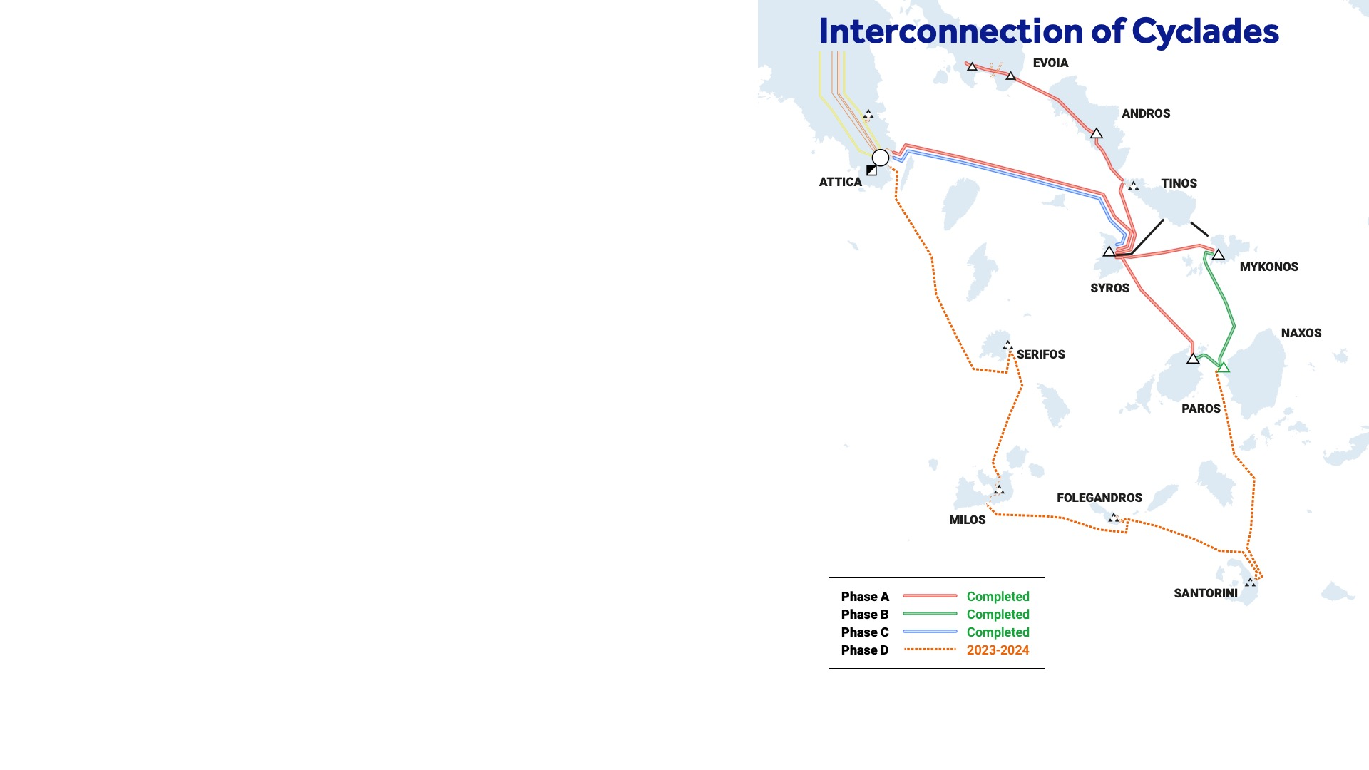


02
Scope
Cyclades Phase D:
Connection of Western and Southern Cyclades to
the mainland interconnected System.
Extension of the completed interconnection of Northern Cyclades (Cyclades Phases A, B and C).
Islands to be interconnected:
Santorini
Folegandros
Milos
Serifos
Interconnection of Western and Southern Cyclades

Slide 3
03
Project overview (1/2)
Main equipment:
5 underground and submarine cable circuits (~370km)
4 GIS substations (on the islands)
Interconnection topology:
Closed loop
to the interconnected System of Northern Cyclades (via Naxos S/S) and
to the mainland interconnected System (via Lavrio EHV S/S in Attica)
Interconnection of Western and Southern Cyclades

Slide 4
04
Project overview (2/2)
Milestones:
Tender process completion: 2021
Santorini-Naxos interconnection: 2023
Project completion: 2024
Budget:
408M€
(383M€ transmission projects and 25M€ network projects)
Interconnection of Western and Southern Cyclades

Slide 5
05
Interconnection sections
Land cable transmission lines (approx. 19km)
Lavrio, Serifos, Milos from Serifos, Milos to Folegandros, Folegandros, Santorini and Naxos
Submarine cable transmission lines 150kV (approx. 350km)
Lavrio-Serifos, Serifos-Milos, Milos-Folegandros, Folegandros-Santorini and Santorini-Naxos
Construction of 4 new GIS 150kV S/Ss
Serifos, Milos, Folegandros and Santorini
Installation of a Dynamic Reactive Power Compensation Unit (SVC) -100/+50MVAr
Santorini
Interconnection of Western and Southern Cyclades

Slide 6
06
Benefits
Allow the reliable supply of Western and Southern Cyclades.
Create an additional strong connecting route to the mainland interconnected System for all the Cycladic Islands.
Permit the substitution of local conventional power stations (oil-fired).
Reduce CO2 emissions:
~100kt/y in 2025 (first year of full operation)
~120kt/y in 2030
Increase the margin of new RES development in Cyclades.
Interconnection of Western and Southern Cyclades

Slide 7
Thank you

